Slide 1
Students Skill Development System
Prepared by-
Mahi Al Jawad (C153010)
Fokrul Islam Khan (C153017)

Slide 2
2
Students Skill Dev. System
Why?
What?
How?

Slide 3
Why?
Problem with Traditional grading point system
Judges theoretical knowledge only.
Fails to judge practical skill sometimes.
Getting highest grade even cannot ensure highest skill on a subject.

Slide 4
Why?
Problem with Traditional grading point system
Famous universities all over the world arranges “Skill dev. Programs”. Encourages their students in “Skill development activities” rather than suggesting for better CGPA.
These proves the “Error” in our traditional grading point system, at least in a country like Bangladesh.
As a result of these CGPA oriented system some lower ranked universities are producing students with healthy CG but poor skill and practical knowledge.

Slide 5
Why?
Our Goal
To minimize the above mentioned error in GPA system.
Assisting a student to develop his skill with our proposed system.
Making him ready for the upcoming practical challenges in the career and job fields.

Slide 6
What?
Idea at a glance
An embedded web tool with our SWP(Student Web Panel)
Finding out skill development “activities”(if there is any) in respective dept. e.g. Competitive Programming, Hackathon for CSE. Robotics or electronic project shows in EEE, debate or presentation skills in Law or BBA.
According to the performance on those “activities” chosen by the student and certified by the authority along with GPA of the respective semester student will get “SKILL POINT” or ‘SP’.
The value of SP in percentage may reduce the error in GPA system judging student skills.
Students can be given waiver or any kind of advantages by the authority to be encouraged in developing himself.

Slide 7
How?
Architectural Design
SP
Where (x+y+z)% = 100%
X%
y%
z%
GPA
Fields
Onsite Events
k1%
k2%
kp%
E1
E2
… … …
Ep
i1%
i2%
in%
F1
F2
… … …
Fn
‘F’ stands for ‘Field’
‘SF’ stands for ‘Sub-Field’
‘E’ stands for ‘Event’
j1%
j2%
jm%
SF1
SF2
… … …
SFm
Fig: Architectural Diagram of the System to calculate SP(Skill Point)

Slide 8
How? (Implementation)
Fields will be given by the dept. ‘experts’ (e.g. Trainer, teacher or advisor).
Example for ‘field’ is ‘Competitive Programming’, ‘App Development’ etc.
Sub-fields will also be given by the ‘experts’.
Example for ‘Sub-field’ is Codeforces, Uva OJ, Light OJ, Topcoder in case of ‘Competitive Programming as ‘Field’.
Experts will define a target for each of the ‘SF’s for a student of a particular semester. Ex: A student gets 100SP if he has Codeforces rating 1400 in 3rd semester.
An expert will define any Fields or Sub-fields compulsory or optional for the students.
Onsite Events like Hackathon or NCPC performance can be added by the student and will be verified and given point by the ‘expert’s.

Slide 9
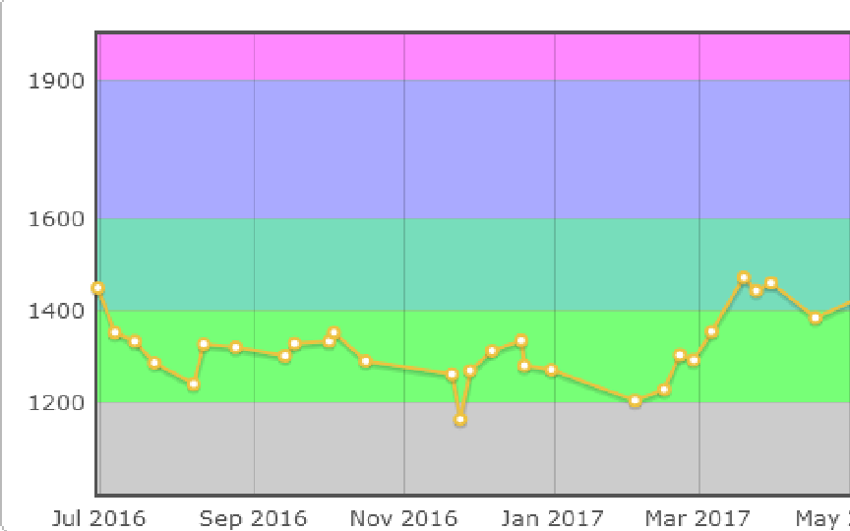
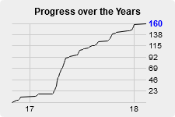
How? (Implementation)
The values of x, y, z, i, j, k percentages will be defined by the ‘expert’s of the dept.
By taking the Sub-field’s SP(Skill Point) in each of the defined fields and with those above percentages we can calculate the total SP of a Student.
Fig: Codeforces Rating
Fig: Uhunt Rating for Uva

Slide 10
Feasibility Challenges
How to compare between two Fields or Subfields or between two different events?
Just like we compare between two subjects in our traditional System and we set a credit on each. This could be done by selected ‘Experts’ in any particular university by legislation.
What about other depts. where there is no Skill Development activities at all?
As SP includes values of x% of CGPA then simply we can take x%= 100% to handle those cases.

Slide 11
Jazakallahu Khairan

